Slide 1




EyeOrder2
Project Architecture (Front-END)
EyeOrderCore
Lerna’s MonoRepo
Yarn
Workspaces
Bill And Replace
Cycle Count
UI Component Lib.

Slide 2
Bill And Replace
The Bill And Replace is an android Based APP that has 5 screens overall
Home
(Default)
Settings
Scan Flow
(Main and Core component)
Basket Stack
Order History
The Scan Flow is the most important part of the Bill and Replace app, playing a major role in scanning barcodes and QR codes using both the scanner and the camera, as well as through manual input.
The Home screen is the main page of the app, featuring device stats, basket status, and sync status.
The Settings screen contains error logs, synchronization options, and user preferences.
The Basket Stack screen has two tabs: Lens Basket and Non-consignment Basket.
The Order History screen displays all order history logs, including pending and completed orders. All associated emails and data are accurate.

Slide 3
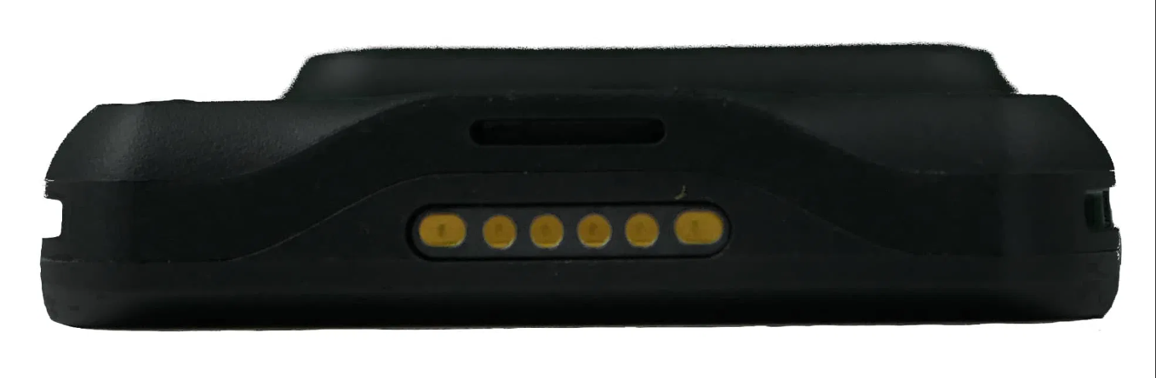
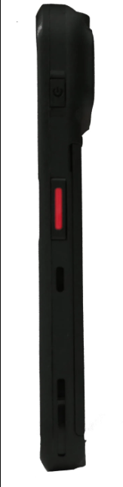
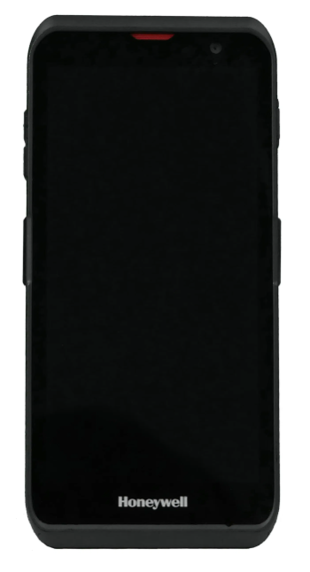
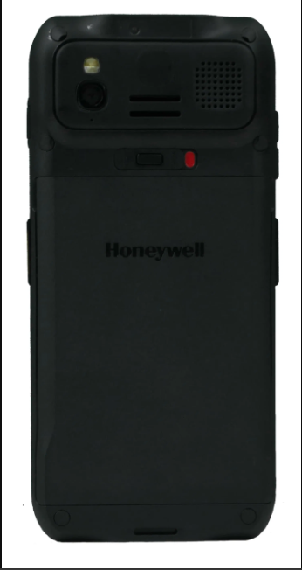
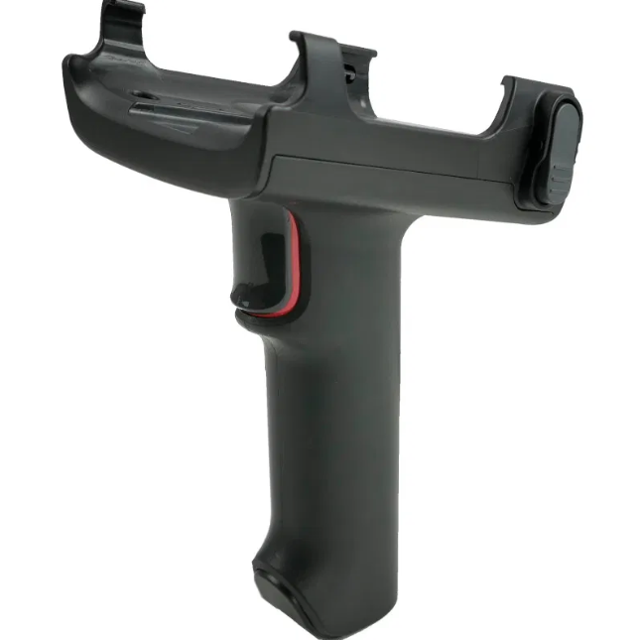
Scan Flow
(Main and Core component)
Honeywell EDA52
Scanner
Laser Mode: Designed for the Honeywell device, users press a hardware button to activate the scanner. It scans barcodes without displaying a keyboard, extracts important details from a barcode, such as the product ID (GTIN), lot number, expiry date, and serial number. Bausch uses the GTIN field, which is similar to the European Article Number (EAN), to uniquely identify products. using a hidden input field. Successful scans provide 500ms of haptic feedback(vibrates), and the data is processed and sent to the server.
Front Display (Touch)
Camera
Camera Mode: For non-Honeywell devices, users can switch to this mode to scan barcodes using the camera.
Manual Entry: If scanning fails, users can enter data manually via front display (touch). (can be used only if none of the above works.)
Before all this, there is a registration step where Bausch customers need to register their devices to get started.
Pistol Grip with trigger

